Slide 1
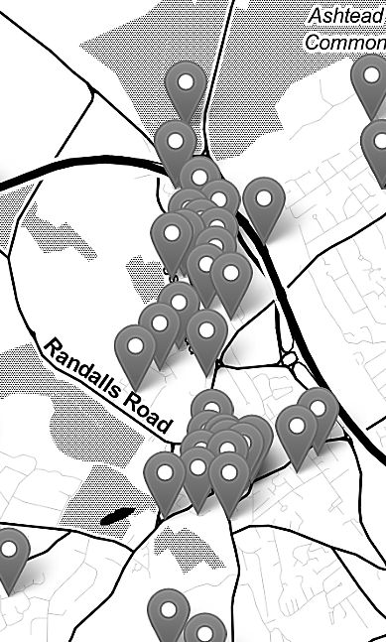
Mapping Crime Data in R: An Introduction to GIS and Spatial Data (13/02/2024 and 16/02/2024)
Nadia Kennar, Research Associate at the UK Data Service (Cathie Marsh Institute, UoM)
Copyright © 2024 University of Manchester, Cathie Marsh Institute, UK Data Service.

Slide 2
Upcoming UKDS Events:
Data in the spotlight: Large scale social surveys (FEB 14 2024, 10:00 AM)
Safe Researcher Training (FEB 21 2024, 10:00 AM)
Computational social science drop-in (MAR 12 2024, 1:00 PM)
Coding in public: Barriers to reproducibility (MAR 19 2024, 9:30 AM)
For the full list of events browse our event page
https://ukdataservice.ac.uk/training-events/

Slide 3
Interaction
During this workshop you can use the Zoom chat for technical questions or comments (to chat with the facilitator – Emma Green).
If you want to ask questions in relation to the content of this talk, then you can use the Zoom Q+A function.
This Workshop will involve several polls, short answers and other interactions where all answers will appear anonymously on the screen. For this, you need to go to menti.com and enter the 8 digit code at the top of the screen .
Lets test this now!

Slide 4
Instructions
Notes:
MENTI

Slide 5
Can you hear me poll
Notes:
MENTI

Slide 6
Troubleshooting audio problems
Check your speaker/headset is plugged in / volume is on.
Click on audio to change to listening via phone
This workshop is live on YouTube. We are also recording this workshop and will post it on YouTube (https://www.youtube.com/user/UKDATASERVICE)

Slide 7
Workshop Content – 13th February 2024
What is GIS
Spatial Data vs Non-Spatial Data
Different types of maps (reference vs thematic)
Projection Methods and Coordinate Reference Systems
Spatial Relations (and/or spatial statistics)
Spatial autocorrelation
Spatial interpolation
Hot spot analysis
Data sources for crime and GIS
Challenges of Mapping Crime Data

Slide 8
Live Code Demo – 16th of February 2024
Topic 1 – Descriptive analysis of crime data
Topic 2 – Shapefiles
Topic 3 – Combining census data (crime rate)
Topic 4 – Spatial Relations/statistics
Extra Topic – Interactive maps via Leaflet Package

Slide 9
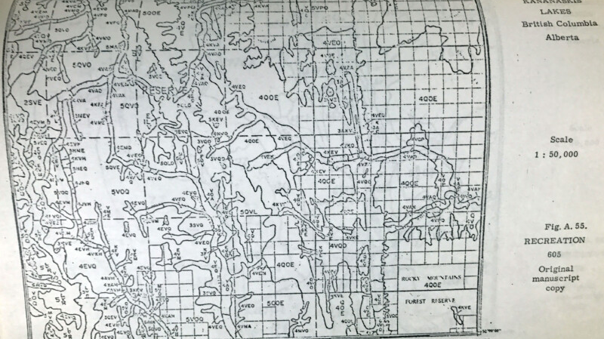

What is GIS?
Graphical Information Systems:
“computer system for capturing, storing, checking, and displaying data related to positions on Earth’s surface”

Slide 10
example
A) interested in identifying the ten cities with the highest average income scores
B) interested in identifying whether these ten cities are geographically clustered
City | Score
Cupertino | 17.2
Doha | 13.5
Dubai, | 22.4
Geneva | 11.5
Hong Kong | 78.3
Luxembourg City | 45.3
Mountain View | 74.2
San Francisco | 12.9
Singapore | 56.8
Zurich | 45.7

Slide 11
Spatial data example
City | Score | Spatial Boundaries
Cupertino | 17.2 | SW: (28.00, 45.09) NE: (28.09, 45.16)
Doha | 13.5 | SW: (-60.38, 147.45) NE: (-60.32, 147.52)
Dubai, | 22.4 | SW: (48.62, 146.83) NE: (48.66, 146.93)
Geneva | 11.5 | SW: (-81.64, -174.64) NE: (-81.56, -174.58)
Hong Kong | 78.3 | SW: (69.11, 60.87) NE: (69.18, 60.92)
Luxembourg City | 45.3 | SW: (37.10, -123.11 NE: (37.19, -123.06)
Mountain View | 74.2 | SW: (12.87, 132.36) NE: (12.91, 132.46)
San Francisco | 12.9 | SW: (-47.69, -169.90) NE: (-47.68, -169.87)
Singapore | 56.8 | SW: (-72.25, -178.46) NE: (-72.23, -178.40)
Zurich | 45.7 | SW: (-84.93, -163.24) NE: (-84.88, -163.21)

Slide 12
Continued.
All data in GIS are ‘georeferenced’ meaning it has both;
Attribute (what it is)
Location (where it is, a known location)
-
Georeferenced = is a digital map or image that has been tied to a known earth coordinate system.

Slide 13

What software's are available?
GeoDa
ArcGIS
FME
QGIS
R
…

Slide 14
What software have/do you use for GIS/Spatial Analysis?
Notes:
Mentimeter

Slide 15
How is GIS used?
Identify problems
Monitor change
Manage and respond to events
Perform forecasting
Set priorities
Understand trends
Reference: https://www.esri.com/en-us/what-is-gis/overview#liSwitcher

Slide 16
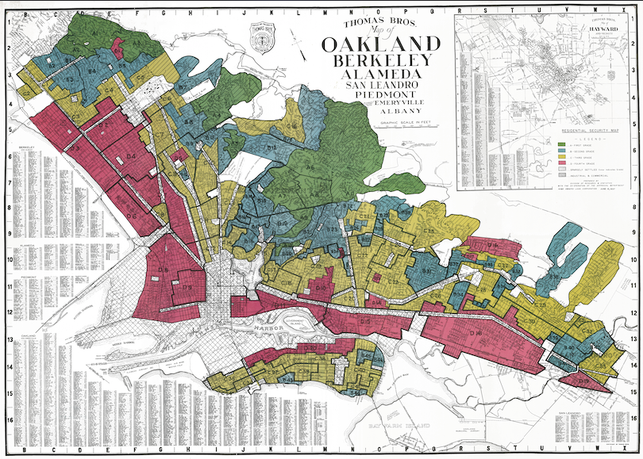
'Redlined Maps’
The history of ‘Redlined’ maps
The social effects
The physical environment

Slide 17
Here are just some of the questions that GIS allows us to explore with crime data.
Where are the most vulnerable communities located?
Why do crimes occur in one area and not the other
How do offenders travel to the crime location?
Where are there more or less stop and search than we would expect in relation to the distribution of crime?

Slide 18
Reference vs Thematic Maps
Reference Maps: used to communicate location on more static data points
To ‘pin point’ data on a map
Descriptive
Thematic Maps: used to highlight a spatial relationship
To ‘study a theme’ within a map
Explanatory

Slide 19
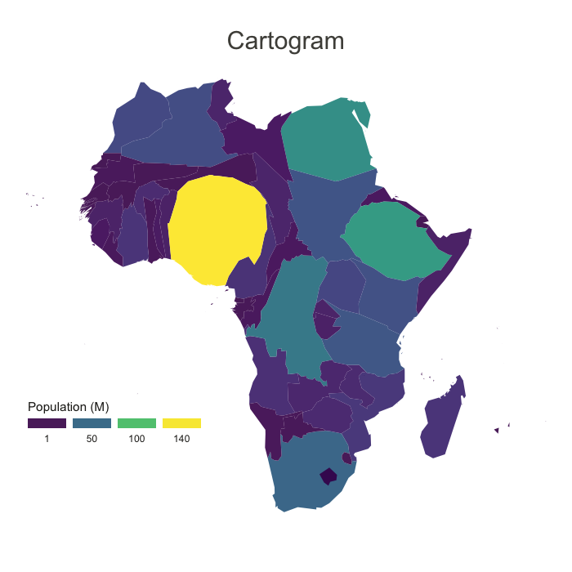
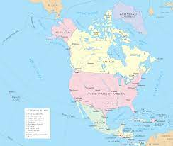
Reference vs Thematic Maps Continued…
Vs

Slide 20
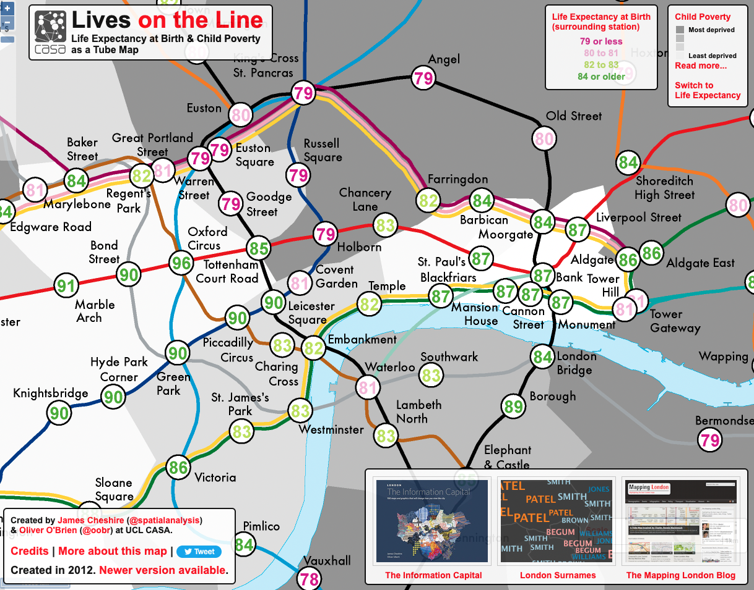
Tube Map Example (source = https://www.crimrxiv.com/pub/slkb1v54/release/1)

Slide 21
Tube Map Example
How do we class Tube Maps;
Reference maps because…
They show the location of different tube stations, and the location of each tube line
Thematic maps because...
They can be used to predict life expectancy, poverty and median house prices
Have a go exploring this!!
https://tubecreature.com/#/livesontheline/current/same/U/*/FFTFTF/11.469326848406268/-0.1622/51.5142/

Slide 22
Scenario 1: The visualisation of road networks to improve road safety measures are a type of
Notes:
MENTI

Slide 23
Scenario 2: The visualisation of the earths surface, showing its elevation, is a type of
Notes:
MENTI

Slide 24
Scenario 3: Navigation tools such as Google maps or City-Mapper can be classed as
Notes:
MENTI

Slide 25
To sum up
All though maps falls broadly into two categories, there are ways in which these types of map overlap or share similarities
Almost every thematic maps is also a reference map, but not every reference map is a thematic map
The decision is up to you, it is not entirely necessary to define these in your work but it is important to now what type of map you want to make as these can be affected by the data you have

Slide 26
Can you give examples of any other types of map that share qualities of both thematic and reference maps?
Notes:
MENTI

Slide 27
What is Spatial Data?
Spatial data (or geospatial data) is a data frame that contains information about a specific location, which can be analysed to better understand that location.
GIS enables this spatial data to be processed and analysed.
Two types: Vector and Raster

Slide 28
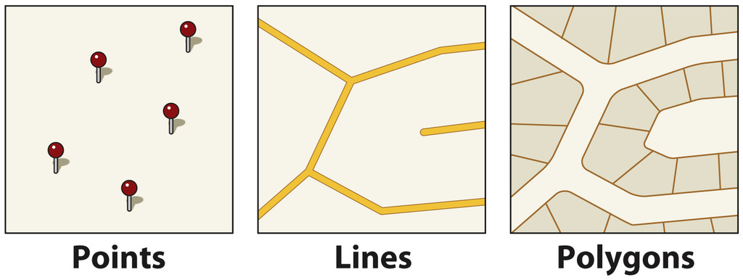
Vector Data
Vector Data (points, lines and polygons)

Slide 29
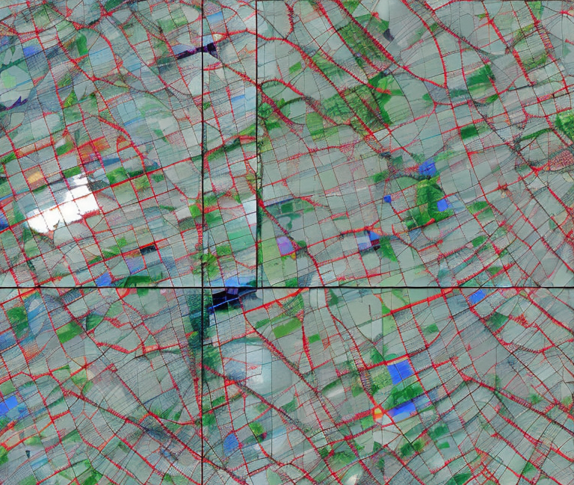
Raster Data
Imagery or satellite data that are formed from a grid of pixels.

Slide 30
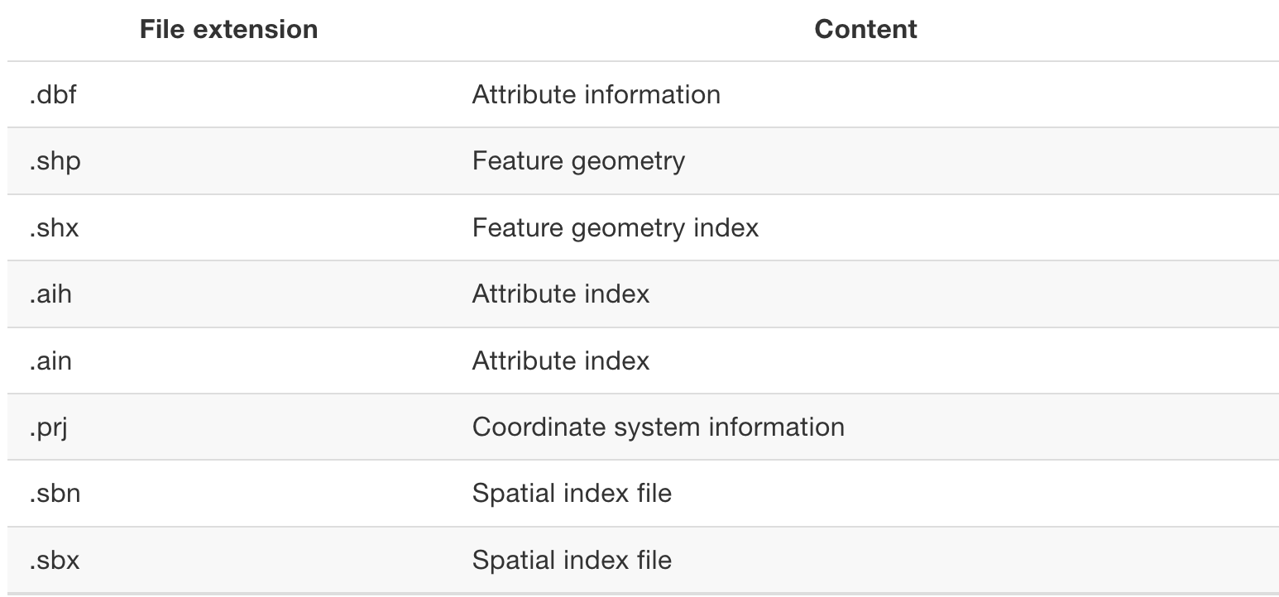
GIS Data Management
GeoTiff files are commonly used for raster data
Shapefile files are commonly used for vector data. Here’s a file extension…
Notes:
- https://mgimond.github.io/Spatial/gis-data-management.html

Slide 31
Managing GIS files in R (vector data)
Example Code:
library(sf)
shapefile <- st_read("path/to/your/file.shp")
shapefile_transformed <- st_transform(my_shapefile, crs = 4326)
str(shapefile_transformed)
summary(shapefile_transformed)
Plot(shapefile_transformed)
ggplot(data = shapefile_transformed) + geom_sf(aes(fill = attribute))
Key Packages:
sf (Simple Features): A modern approach to managing spatial data, supporting simple features for R.
rgdal: Provides bindings to the GDAL (Geospatial Data Abstraction Library) for reading and writing a wide range of formats.

Slide 32
Modifiable Arial Unit Problem (MAUP)
“MAUP refers to the cartographic representation of data whose attributes are significantly influenced by the spatial scale used”
Two key Aspects:
Scale Effect: Changing the size of the spatial units (e.g., from neighbourhoods to districts) can alter statistical results, such as means or totals.
Zoning Effect: Altering the shape or configuration of spatial units, even if the scale remains constant, can also impact results.

Slide 33
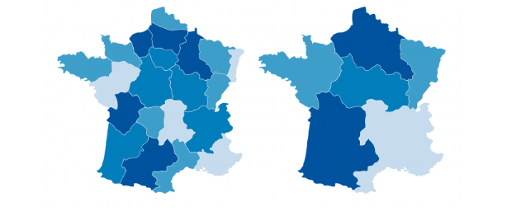
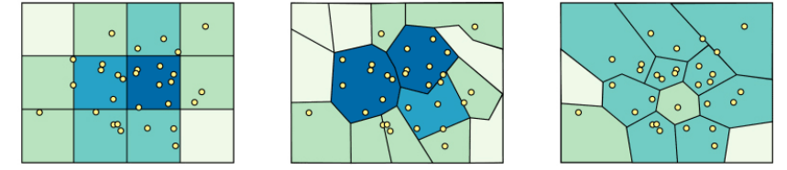
Zone vs scale effect
Scale Effect:
https://gisgeography.com/maup-modifiable-areal-unit-problem/
Zone Effect:
http://www.e-education.psu/edu/geog486/l4_p7.html

Slide 34
Mentimeter question
Question: True or False: The scale effect in MAUP refers to changes in statistical results caused by the size of the geographical units used in the analysis. he analysis.
Notes:
Answer TRUE: The scale effect refers to changes in statistical results caused by the size of the geographical units used in the analysis.

Slide 35
Mentimeter question 2
Question: Which of the following best describes the aggregation effect in MAUP?A) It refers to the impact of data collection methods on analysis outcomes.
B) It describes how the arrangement and shape of spatial units can alter statistical results.
C) It is the effect of atmospheric conditions on aerial unit measurements.
D) It denotes the influence of unit size on data storage requirements.
Notes:
B) It describes how the arrangement and shape of spatial units can alter statistical results.

Slide 36
Mentimeter question 3
Question: What are some potential implications of ignoring the MAUP in crime spatial analysis? spatial data analysis?

Slide 37
Break

Slide 38
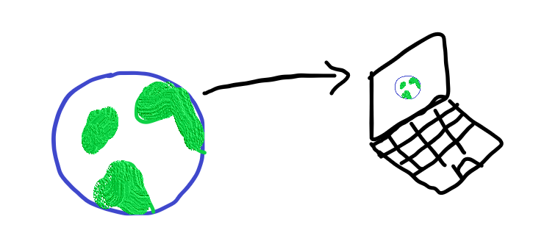
Projection Methods
Moving from the 3D to the 2D

Slide 39



Football Example

Slide 40
Distortion
The misrepresentation of…
-> Area
-> Shape
-> Distance
-> Direction of points

Slide 41
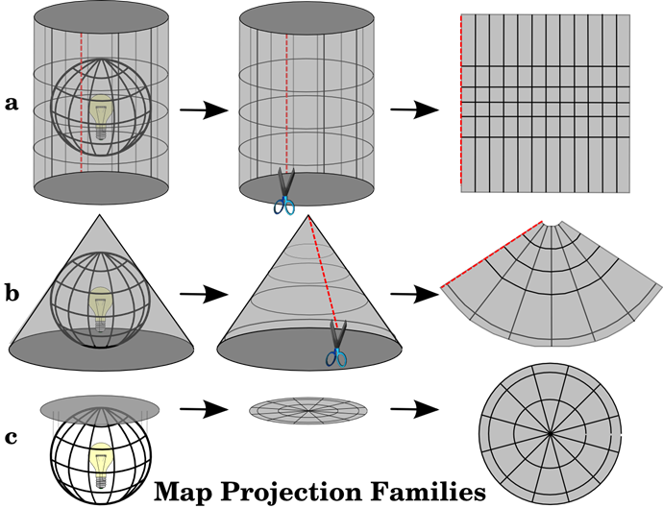
Distortion..
Cylindrical
Conical
Planar

Slide 42
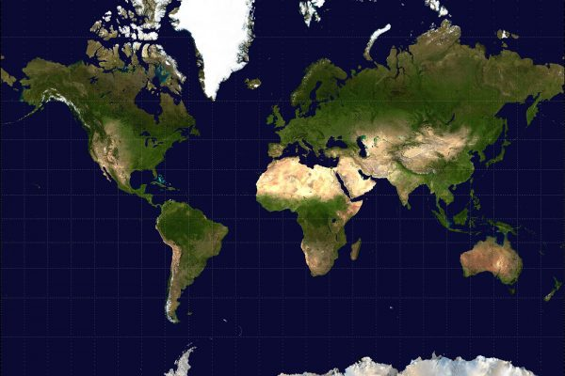
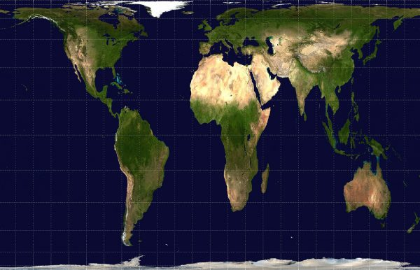
Web Mercator vs Gall-Peter Projection

Slide 43
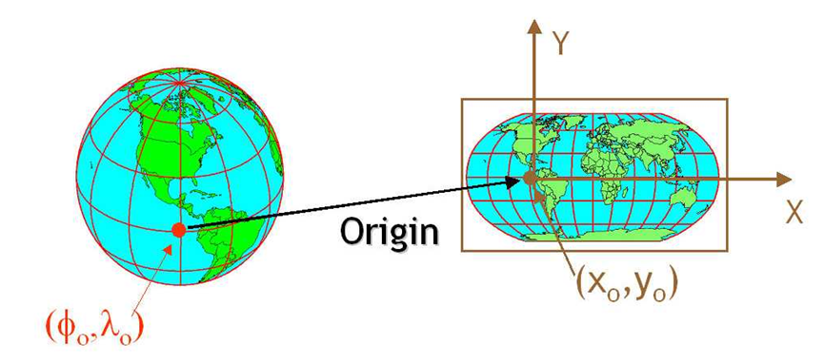

So, how do we actually move from the 3D to the 2D?

Slide 44
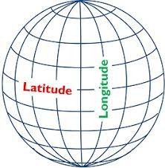
Coordinate Reference Systems (CRS)
The move from the 3D to the 2D is done with the help of CRS
Every place on earth is specified by three numbers (i.e. coordinates)
Latitude, longitude and Altitude
Notes:
A geographic coordinate system (GCS) is a reference framework that defines the locations of features on a model of the earth. It’s shaped like a globe—spherical. Its units are angular, usually degrees.
A projected coordinate system (PCS) is flat. It contains a GCS, but it converts that GCS into a flat surface, using math (the projection algorithm) and other parameters. Its units are linear, most commonly in meters.
https://www.esri.com/arcgis-blog/products/arcgis-pro/mapping/coordinate-systems-difference/#GCS

Slide 45
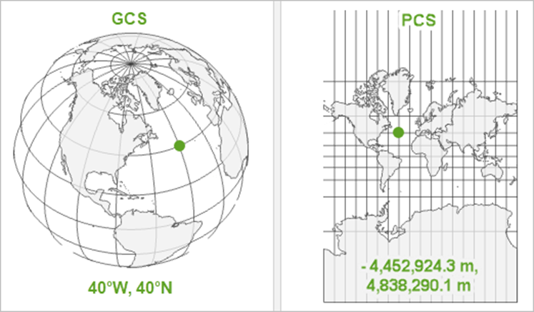
CRS continued…
There are two Main CRS:
Geographic Coordinate System vs Projected Coordinate Systems
The ‘where’
The ‘how’

Slide 46
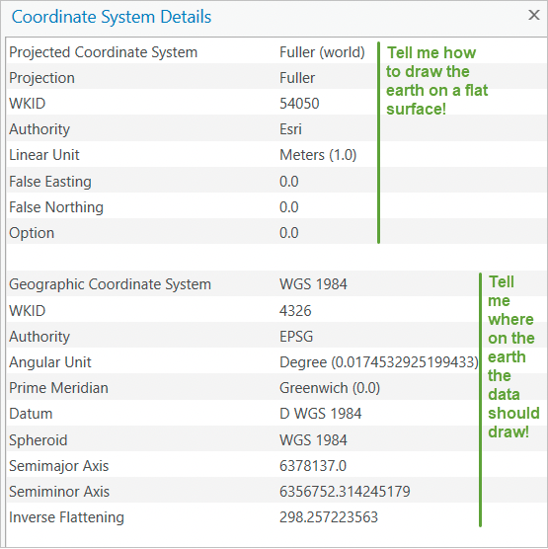
CRS example
CRS example
Remember that a PCS, is just a GCS that has been projected !

Slide 47

Spatial Relations and Analysis in GIS
- Spatial relations refer to the ways in which different locations, areas, or objects are situated in relation to each other on the Earth's surface.
- Spatial analysis refers to studying entities by examining, assessing, evaluating, and modelling spatial data features

Slide 48
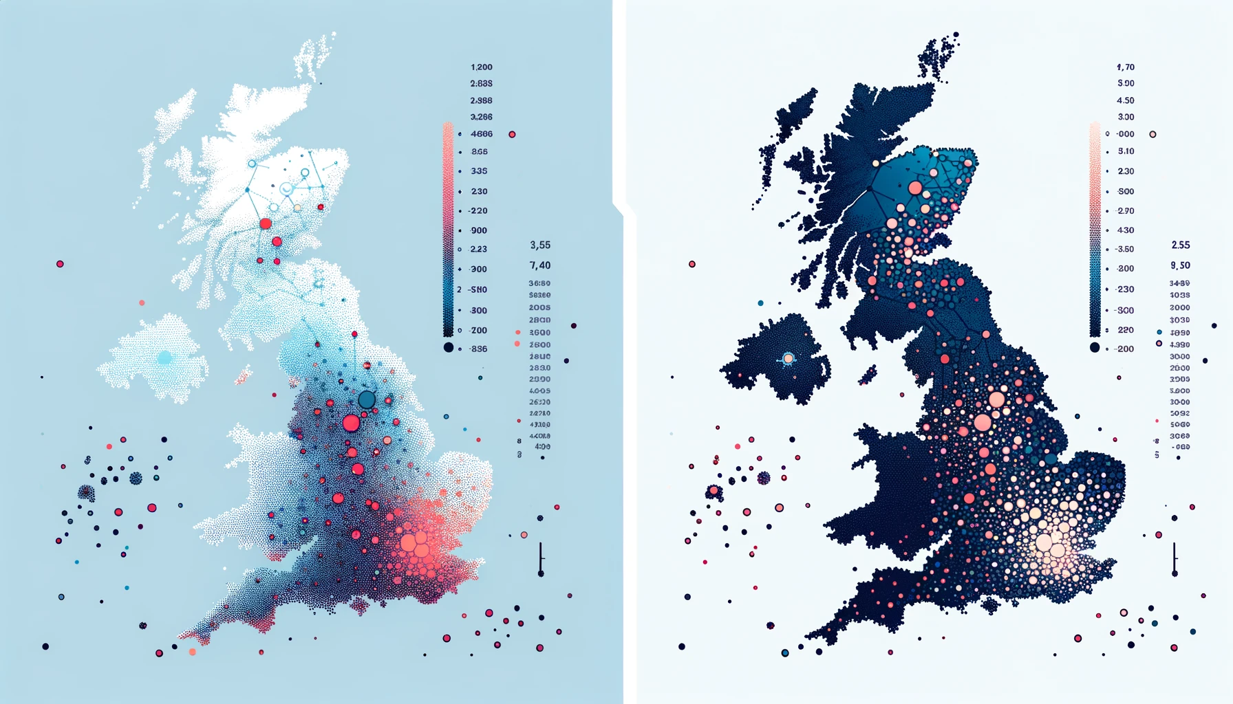
a) Point Pattern Analysis

Slide 49
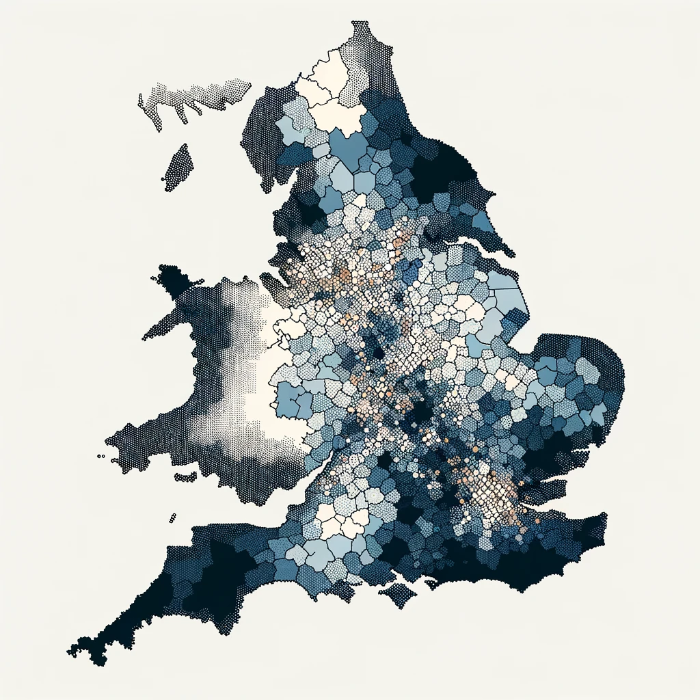
b) Spatial Autocorrelation
This map groups areas with similar crime rates together, using shades of a single color to represent different levels of crime rates, showing patterns of clustering.

Slide 50
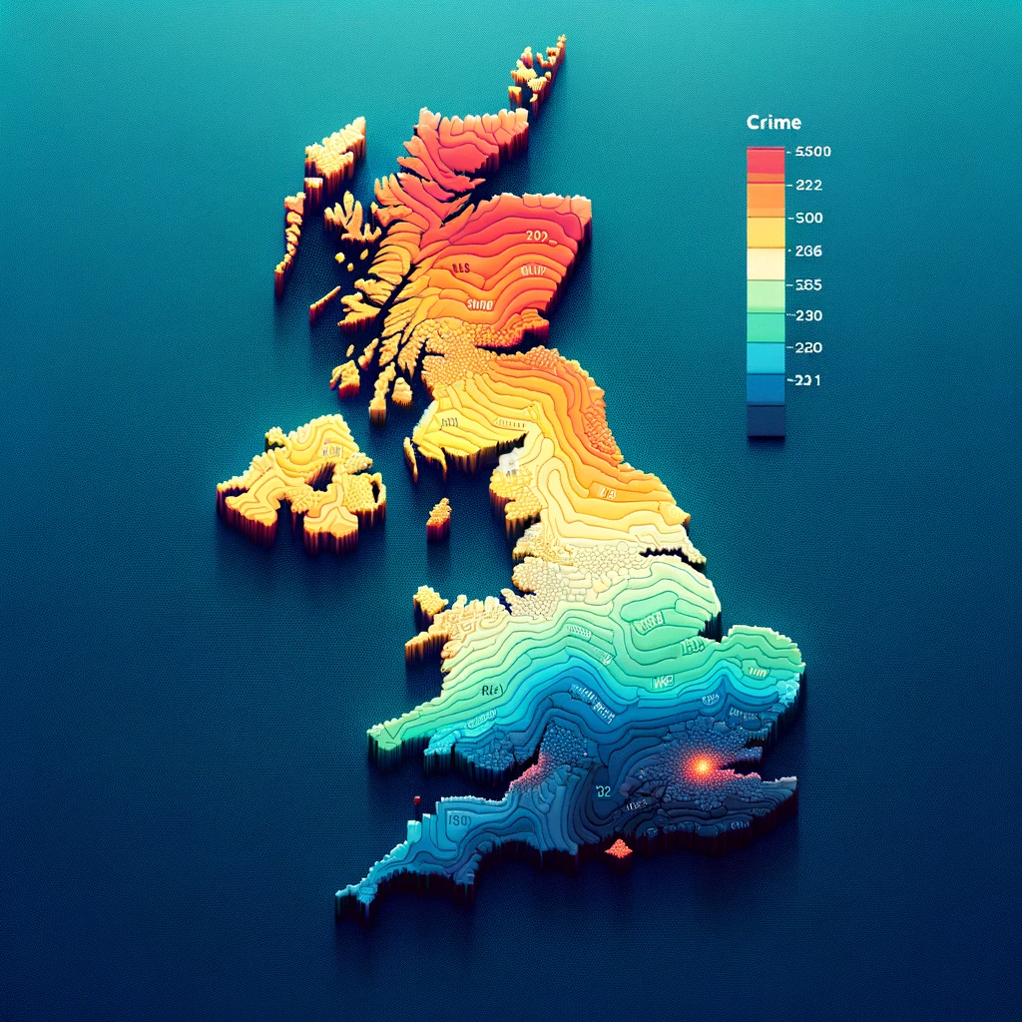
c) Spatial Interpolation
This map uses a gradient of colours to interpolate crime rates between known data points, creating a smooth transition that estimates crime rates in areas with no direct data.

Slide 51
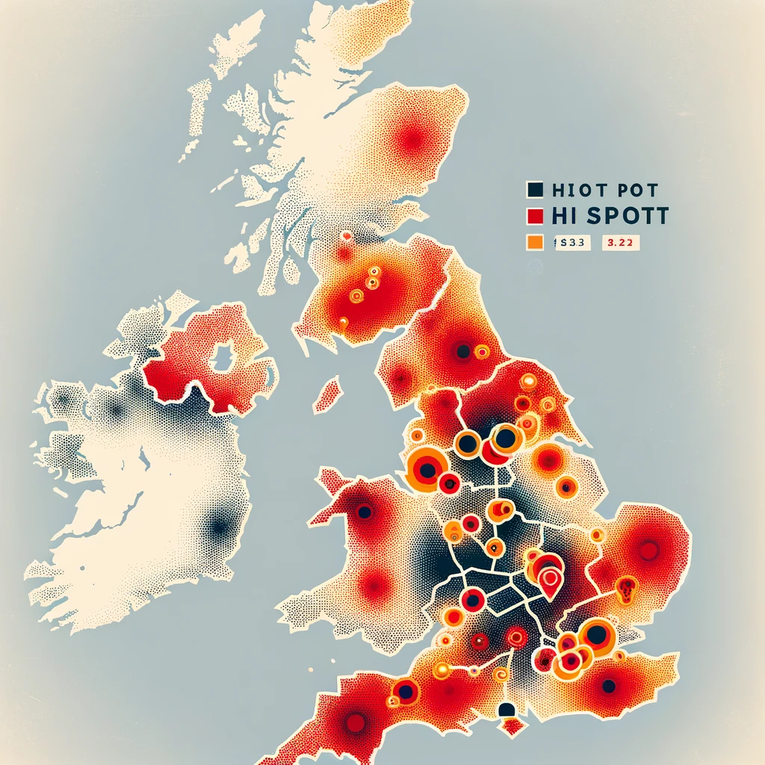
d) Hot spot analysis
This map highlights areas with significantly higher crime rates in bright colours against a neutral background, indicating geographic concentrations of high crime rates and identifying areas needing immediate attention.

Slide 52
Data sources for crime data
Data Sources for Crime Data
UK | Non-UK | R Packages | Other
UK Police Data - Provides street-level crime data, outcomes, and information on the location of the front counter. Office for National Statistics (ONS) - Offers crime statistics for England and Wales. Scottish Government Statistics - Publishes crime and justice datasets for Scotland. Northern Ireland Statistics and Research Agency (NISRA) - Provides crime and justice statistics for Northern Ireland. London Datastore - Contains datasets specific to London, including the Metropolitan Police Service's crime data. UK Home Office - Publishes research and statistics on various aspects of the criminal justice system. Data.gov.uk - A portal for UK government data, including some datasets related to crime and justice. | FBI’s Uniform Crime Reporting (UCR) Program (USA) - Provides a nationwide view of crime based on the submission of statistics by law enforcement agencies. Bureau of Justice Statistics (BJS) (USA) - Contains criminal victimization data, law enforcement, prosecution, courts, and corrections data. National Incident-Based Reporting System (NIBRS) (USA) - Offers detailed information about crimes reported to law enforcement. European Sourcebook of Crime and Criminal Justice Statistics - Compiles criminal justice data from European countries. INTERPOL’s Crime Data - Allows access to international crime statistics. United Nations Office on Drugs and Crime (UNODC) - Provides global crime and criminal justice statistics. | crimedata: An R package that provides easy access to cleaned and documented criminal incident data from several U.S. cities. UKpolice: An R package that uses the data.police.uk API to provide access to UK police data. opendatatoronto: Although not specific to crime data, this package can access Toronto's Open Data Portal, which includes crime statistics. crimer: An R package that allows users to access and analyze crime data from the city of Baltimore. rdflib: While not a crime-specific package, rdflib can be used to parse RDF/XML crime data provided by some organizations. | Other Resources: GIS Data Repositories: Such as Esri's Open Data Hub or Harvard's Geospatial Library, which offer geospatial data that can be used in crime mapping. Social Media and Crowdsourced Data: Platforms like Twitter and Nextdoor, where users may report crime-related incidents. However, this data is unverified and needs careful processing. Academic Institutions: University crime labs and research centers sometimes share datasets for public use. Private Data Vendors: Companies like LexisNexis provide crime reports and analytics services, though they often require a subscription.

Slide 53
What are the main challenges of mapping crime data?
Geomasking and geoprivacy
The accuracy of police recorded statistics
The grey figure of crime
Conceptual issues surrounding its definitions of crime types
The impacts of seasonality; how has Covid-19 affected police recorded crime statistics
Can you think of anymore?

Slide 54
What are the main challenges of mapping crime data?
Notes:
MENTI

Slide 55
Material for the live code demonstration (08/03/2023)
GitHub:
https://github.com/UKDataServiceOpen/Crime_Data_in_R
(under the Feburary_2024 folder)

Slide 56
Any Questions…

Slide 57
References
https://www.esri.com/en-us/what-is-gis/overview#liSwitcher
https://blog.ukdataservice.ac.uk/gis-spatial-data/
Dermanis (2005) : https://www.researchgate.net/profile/Athanasios-Dermanis/publication/233387161_Coordinates_and_Reference_Systems_in_Greek/links/0912f50a149d9568b7000000/Coordinates-and-Reference-Systems-in-Greek.pdf
Luc Anselin (2009) : https://link.springer.com/chapter/10.1007/978-3-642-03647-7_5
Ratcliffe (2009) Spatial and Temporal Challenges: https://link.springer.com/chapter/10.1007/978-0-387-77650-7_2
Bowers (2001) Mapping and Analysing Crime Data : https://link.springer.com/chapter/10.1007/978-0-387-77650-7_2
https://core.ac.uk/download/pdf/161890428.pdf
https://www.ed.ac.uk/files/imports/fileManager/chainey.pdf
https://www.crimrxiv.com/pub/slkb1v54/release/1
https://tubecreature.com/#/livesontheline/current/same/U/*/FFTFTF/11.469326848406268/-0.1622/51.5142/
https://www.crimrxiv.com/pub/slkb1v54/release/1
https://www.sciencedirect.com/topics/earth-and-planetary-sciences/modifiable-areal-unit-problem
https://engaging-data.com/country-centered-map-projections/
Images on slide 28, 42, 43, 44 and 45 were generated with the assistance of AI. Source: ChatGPT 4 with Dall-E. Date: 07/01/2024.

Slide 58
Survey
When you leave the webinar, please complete our short survey
Just click on ‘continue’ to access the survey.

Slide 59
Thank You.
Email: nadia.kennar@manchester.ac.uk
Twitter: @NadiaKennar

